Slide 1
Understanding the influence of Physical Activity on GPA
Lydia Aubourg & Gabriel Nacmias
Information Visualization Section 12 - Fall 2025

Slide 2
Overview
What Will Be Covered
Our project visualizes fitness data to help beginners understand key health metrics like steps, peak activity minutes, and overall life score and how it affects academics.
Our goal is to create a clear, approachable dashboard and a physical installation that teaches these concepts at a glance.

Slide 3

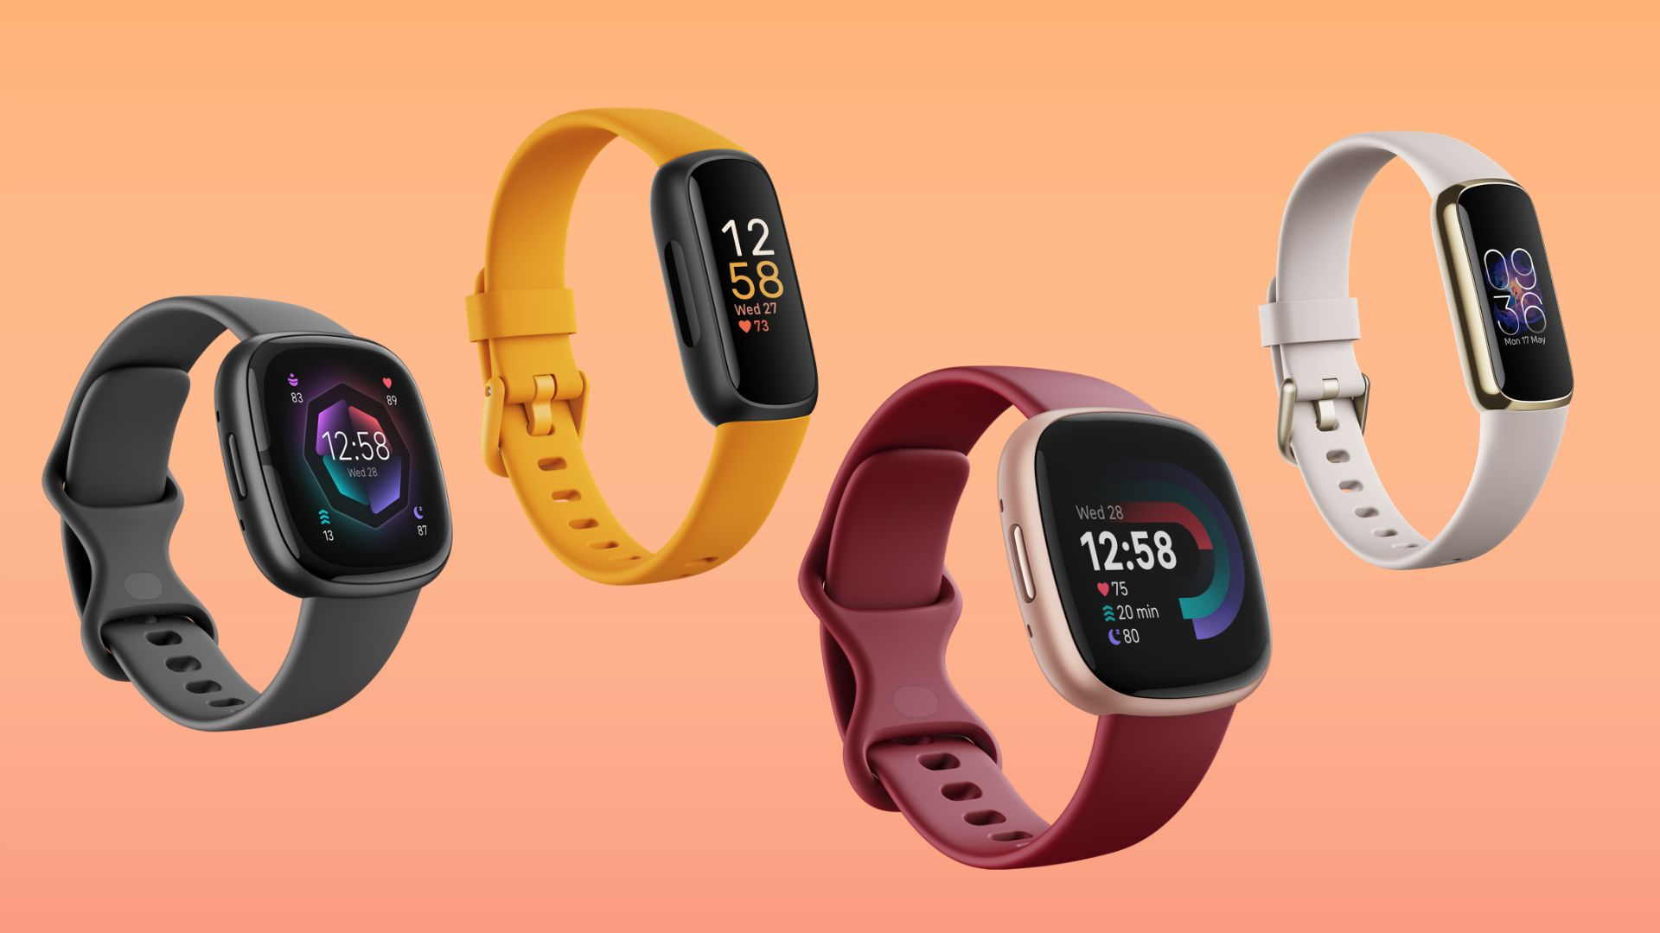
Data Source
Data Set
Origin
Why we chose it?
Fitbits, Field Tests, and Grades. The effects of a healthy and physically active lifestyle on the academic performance of first year college students.
The data was collected during the Fall semester of 2017 from 581 freshmen enrolled at Oral Roberts University in a class entitled “Introduction to Whole Person Education”.
Includes multiple physical activity metrics
Easy to interpret for first-time learners
Supports visual comparisons (steps, heart rate zones, activity minutes, etc.)

Slide 4
Data Preparation
Using Tableau Prep
Steps Taken:
Removed missing or duplicated records
Converted timestamps to readable date formats
Cleaned column names for Tableau
Calculated new metrics (Life Score, averages, totals, etc.)

Slide 5
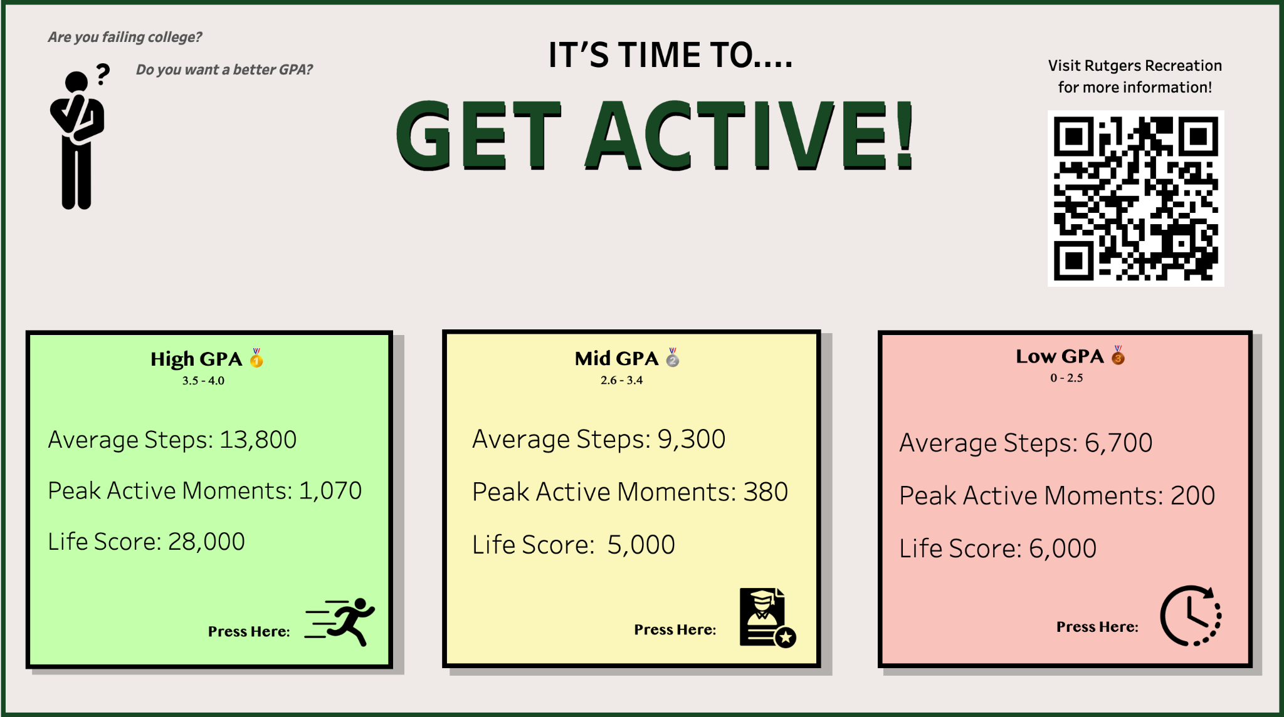
Final Tableau Dashboard
(Interactive Dashboard with icons redirecting you to graphs)

Slide 6
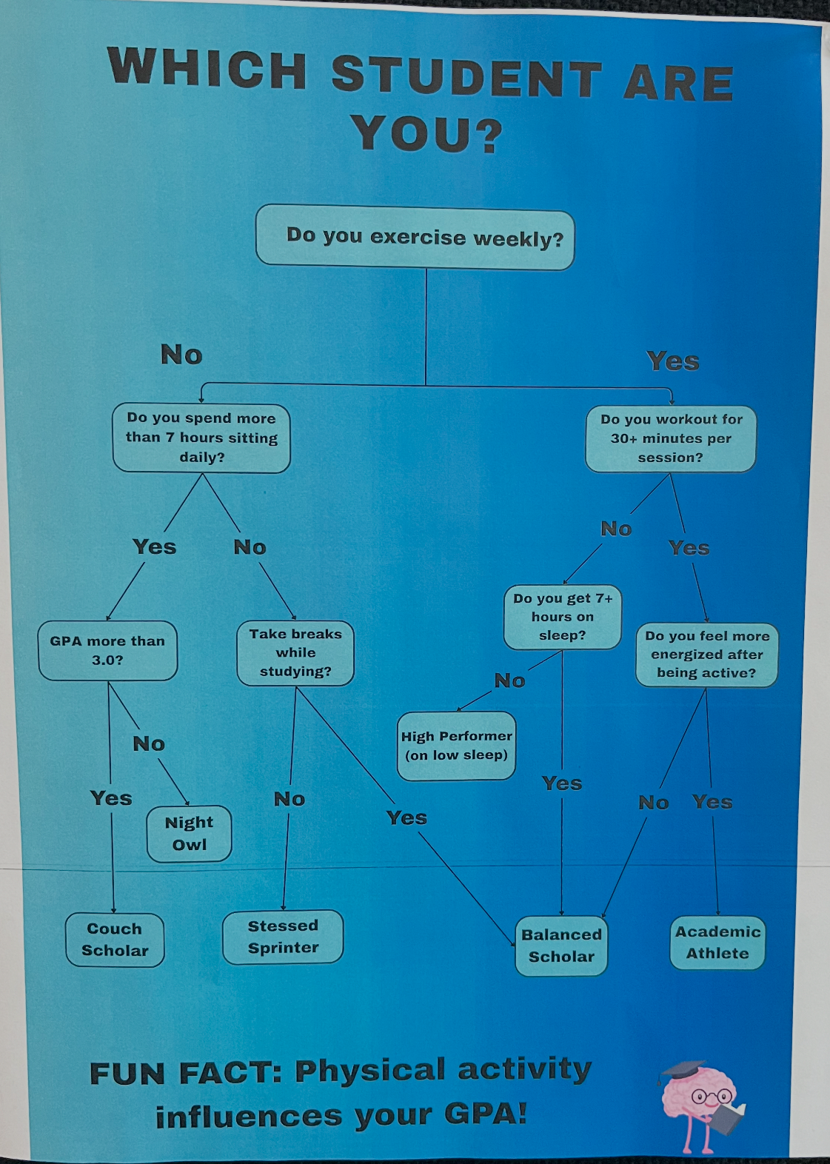
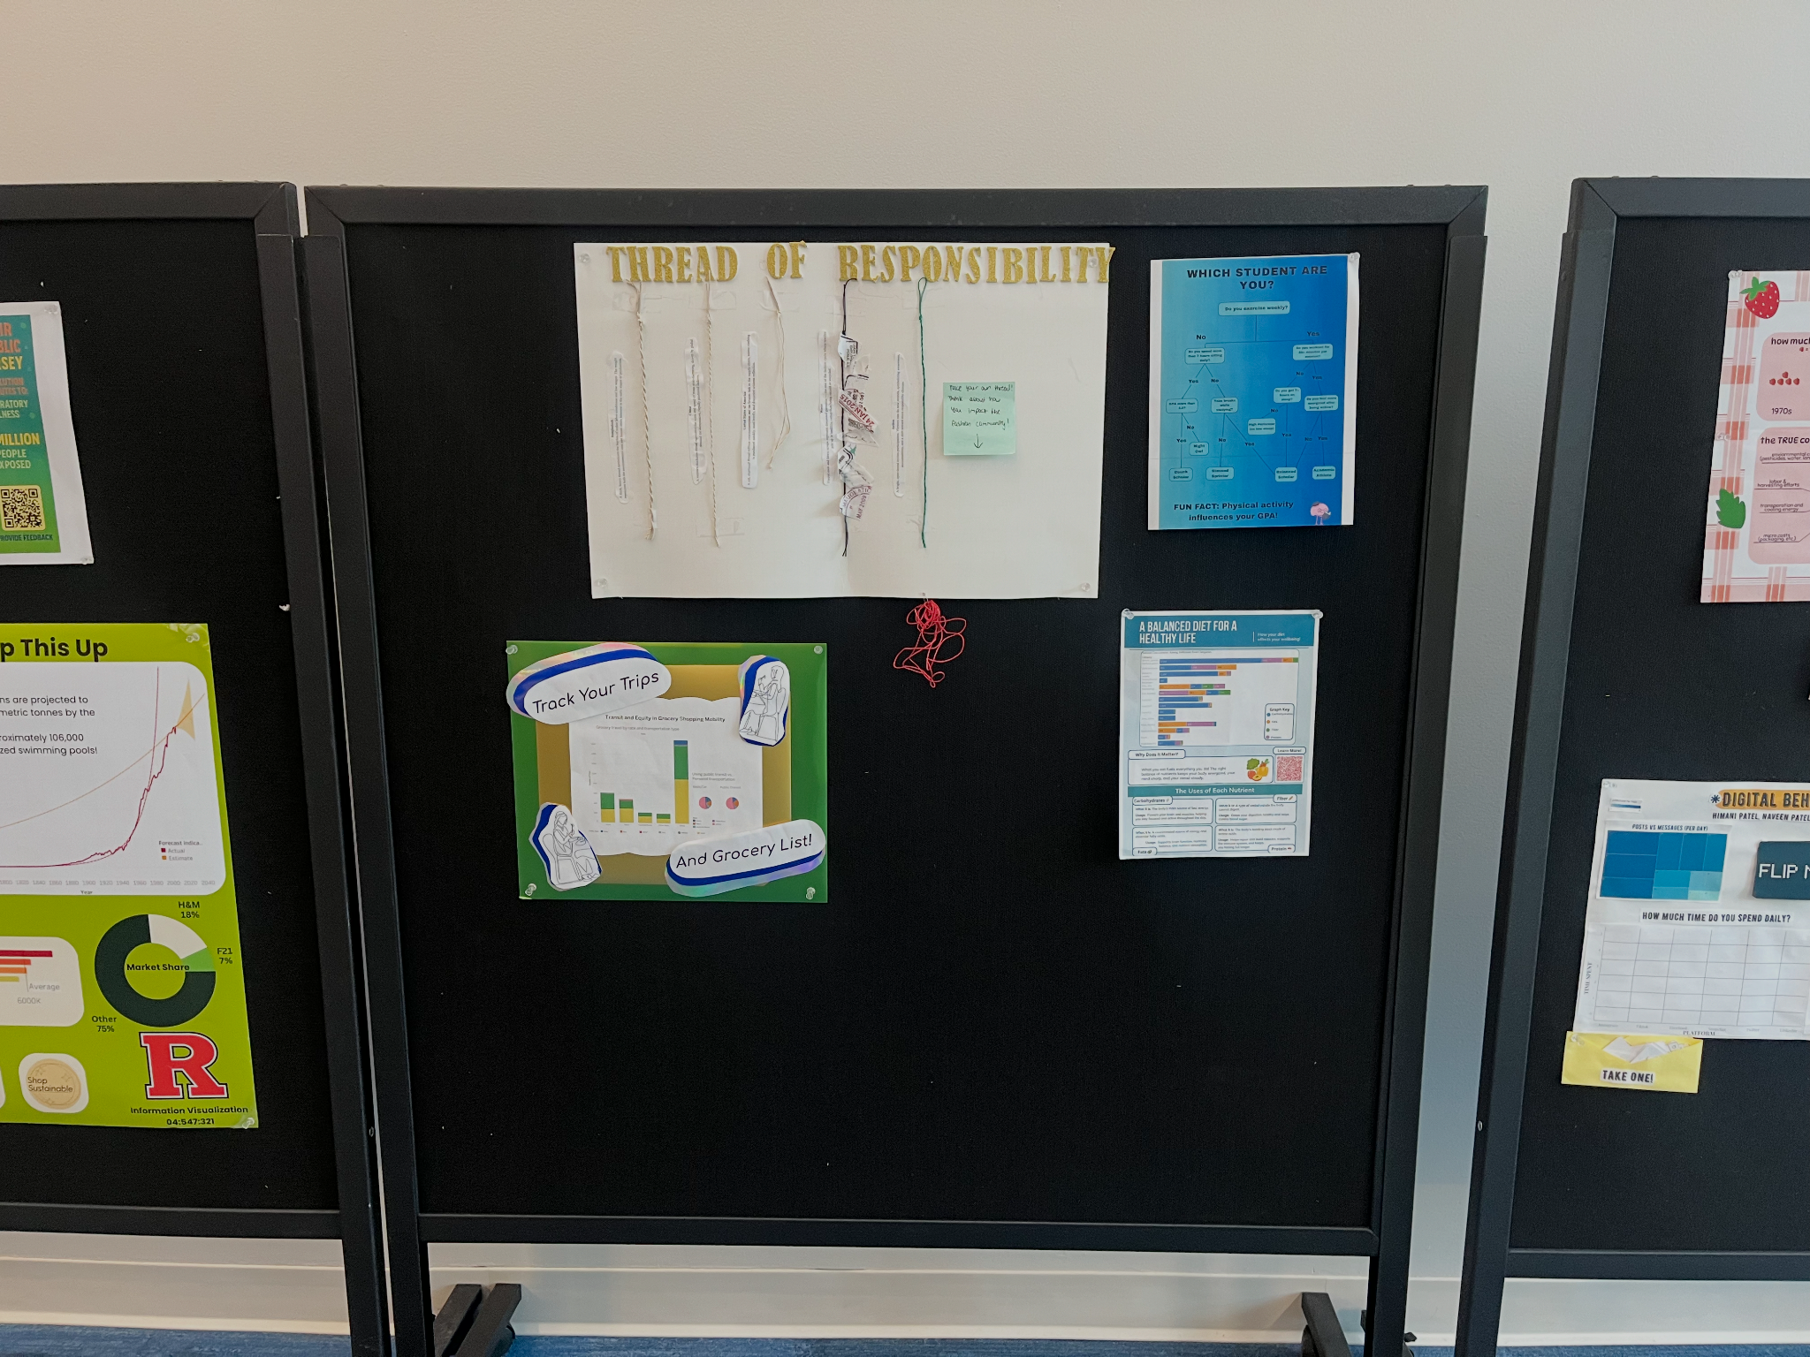
Physical Object
Close-Up & Wide-Shot

Slide 7
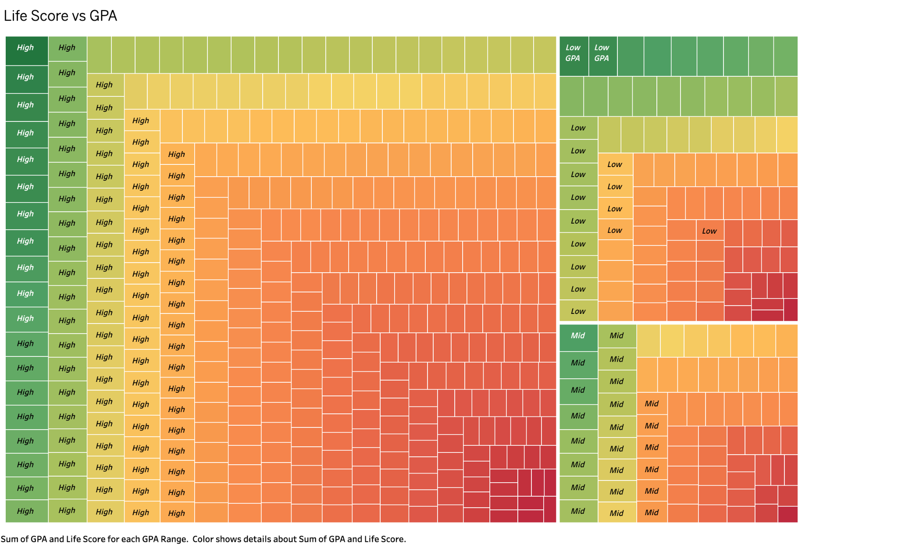
Insights
High GPA students have the highest "Life Scores" (shown by largest green rectangles in upper left)
There's a gradient from high scores (green, upper left) to low scores (red/pink, lower right)
Mid GPA students show more variability in life scores (olive/yellow middle sections)
Low GPA students cluster in lower life score ranges
The visualization suggests holistic wellness (life score) correlates with academic performance
Colors: Using green for high activity and red for low activity so beginners understand quickly, yellow for mid activity

Slide 8
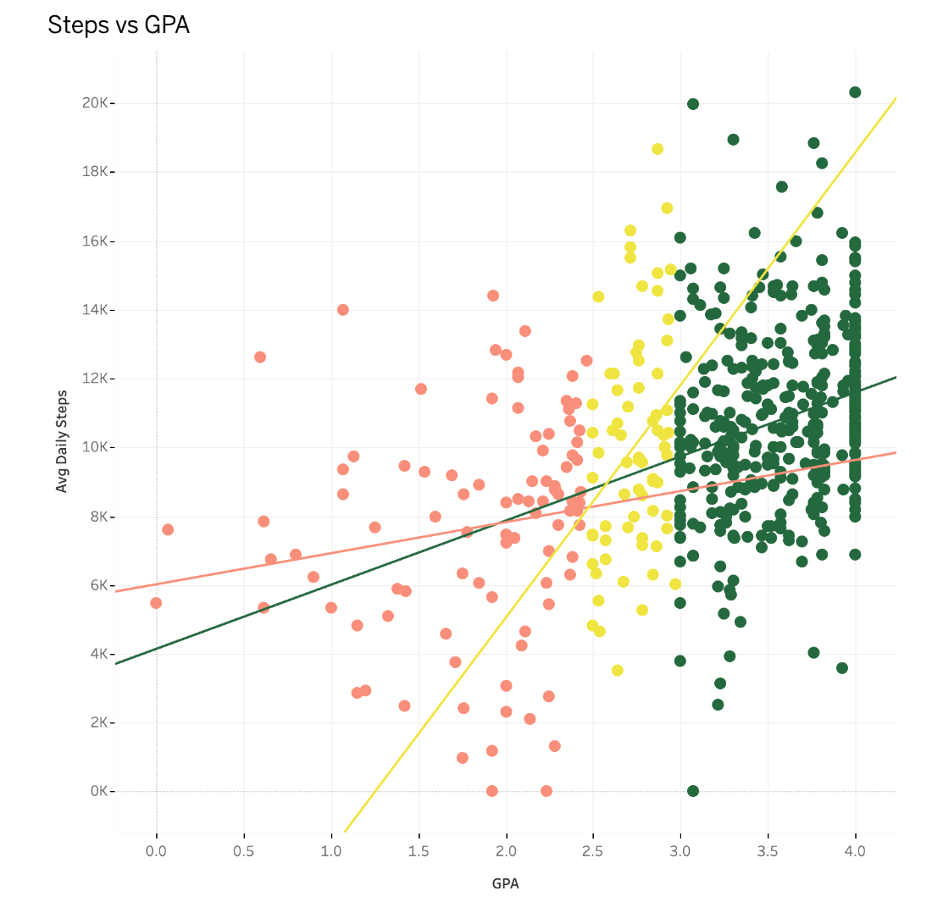
Insights
Shows a positive correlation between daily steps and GPA across all groups
High GPA students (green dots) dominate the dataset and cluster densely in the 3.0-4.0 GPA range with 8k-16k average daily steps
Low GPA students (red dots) are more dispersed and tend toward lower step counts
Mid GPA students (yellow dots) fall between the two groups
The trend lines show steeper slopes for high and mid GPA students, suggesting physical activity may have a stronger relationship with academic performance in these groups

Slide 9
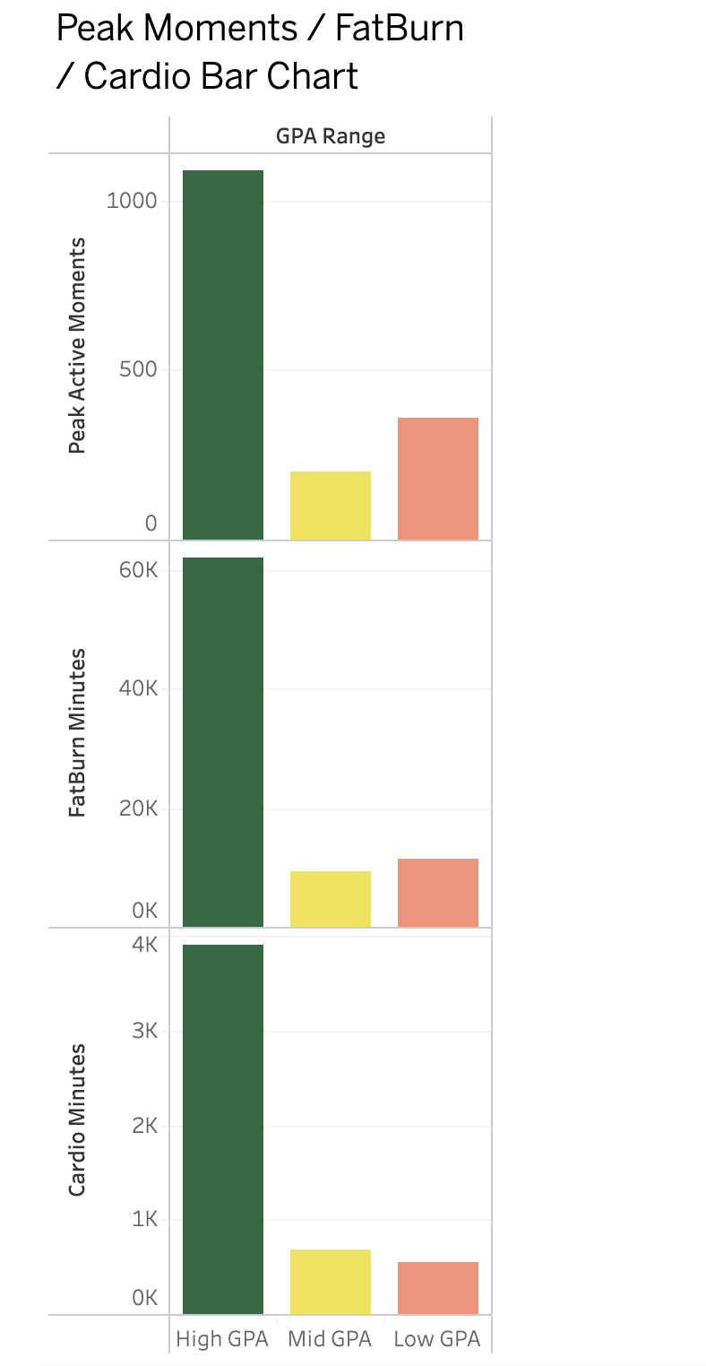
Insights
High GPA students dramatically outperform other groups across all three fitness metrics
Peak Active Moments: High GPA students have 1,100 minutes vs 200 for mid and 350 for low
FatBurn Minutes: High GPA students have 65k minutes - vastly more than mid (8k) and low (10k)
Cardio Minutes: High GPA students have 4k minutes vs 600 for mid and 400 for low
The pattern is consistent: high academic performance correlates with significantly higher exercise intensity and durations

Slide 10
Connections
Physical Object and Dashboard
A personality path that captures attention visually.
It divides students into “active” and “inactive” categories based on behavior and lifestyle.
It’s subtle, something you follow visually to understand where you fall.
Highlights issues of sedentary behavior and its academic impact.
Data-heavy and detailed.
Shows specific metrics (steps, peak active minutes, activity types).
Breaks down GPA ranges and shows how physical activity patterns vary across each level.
Supports motivation by helping users see where they are and how to improve.

Slide 11
Connections contd.
Physical Object and Dashboard
Both pieces reflect the connection between being physically active and being academically engaged. They work together to show how movement habits can influence GPA ranges.
The installation grabs attention, simplifies the idea, and guides people into reflecting on their habits.
The dashboard gives the in-depth evidence and context behind that reflection.
Potential Improvements:
Add a small piece of data directly onto the installation to strengthen the information.
Add more charts or interactive elements in the dashboard to keep users engaged and make exploration more intuitive.

Slide 12
Team Roles
Lydia:
Tableau Dashboard and prep
Gabriel:
Physical object, and formatted presentation

Slide 13
Challenges
Finding the right data source. Originally we had a broad idea on physical activity levels across the country had to narrow it to a specific groups so we chose university students.
Overestimating our physical object size, originally was 24 x 36 but instead was 8.5 x 11

Slide 14
Thank You!

